Slide 1

Sprocket Central Pty Ltd
Data analytics approach
[Division Name] - [Engagement Manager], [Senior Consultant], [Junior Consultant]

Slide 2
Agenda
Introduction
Data Exploration
Model Development
Interpretation

Slide 3
Introduction
Problem Outline
Customer Analysis
Sprocket Central Pty Ltd specialised in high quality bikes and related accessories.
Sprocket has 1000 new customers which can play a major role towards company.
Sprocket wants to analyse new customers’ data to maximize the profits
We will do Data Exploration, Model Development and Interpretation.
Wealth Distribution
Customer Age based behvior
Trends related to Job Industry
State Wise Analysis
Brand Perception and Demand
Effect of pricing on customers
Profit based Analysis

Slide 4
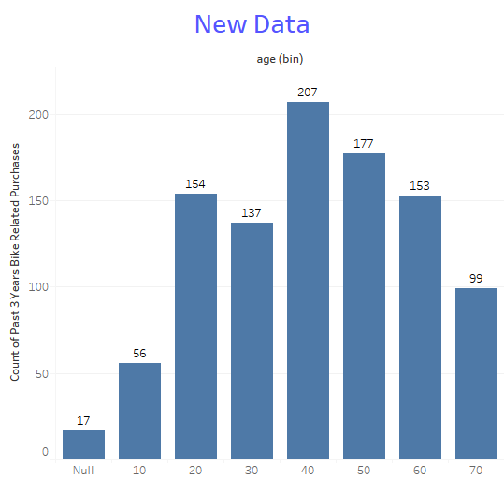
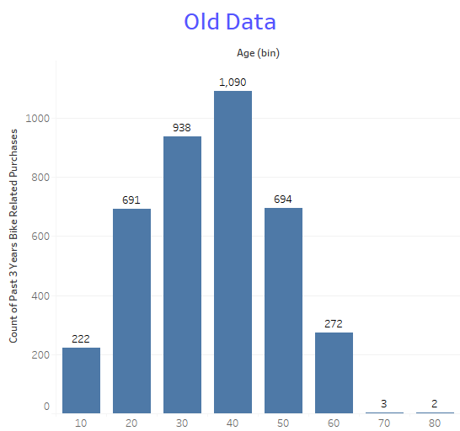
Data Exploration
Age Based Comparison for past 3 years bike related purchases
In old data, most of the purchases were made by age group 40 50 and 30-40 years.
In New Data, Most purchases are also made by 40-50 year olds but also by nearby age groups.

Slide 5
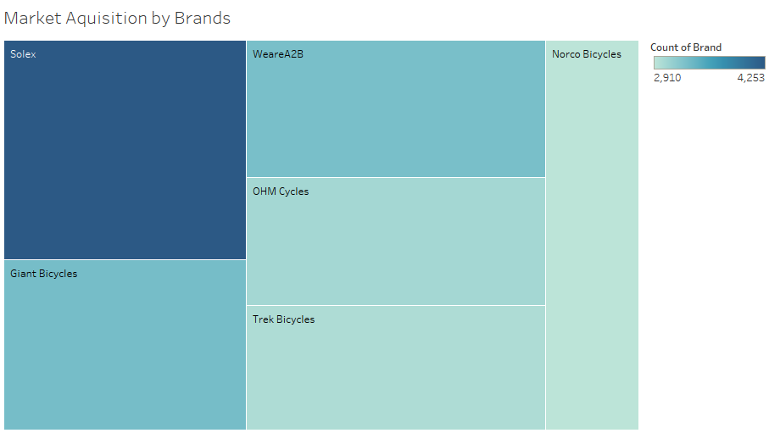
Model Development
Acquisition of Market
The tree map clearly shows that market is mostly captured by Solex and Giant Bicycles.

Slide 6
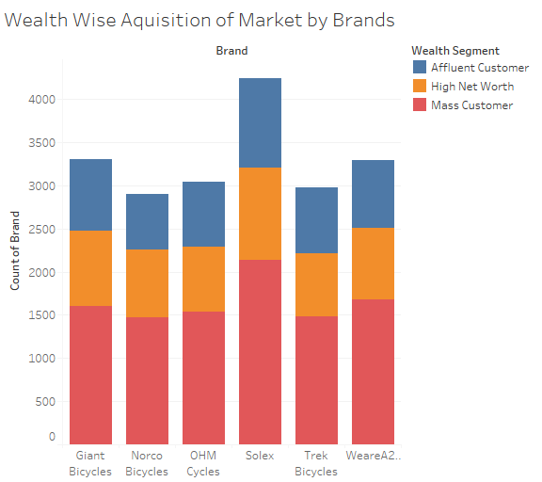
Model Development
Market Acquisition based on Wealth and Brands
The stacked bars showed that Mass customers are biggest users for all brands.

Slide 7
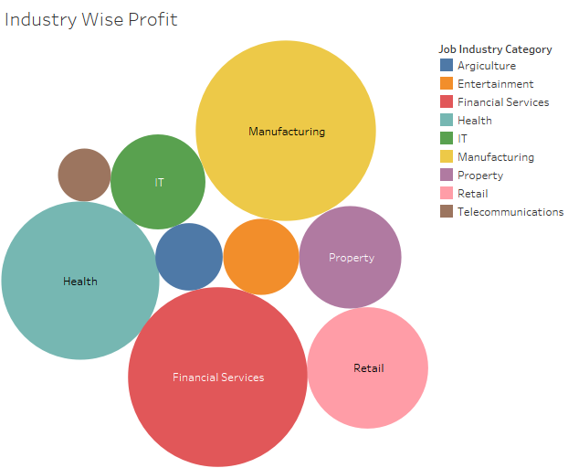
Model Development
Industry Wise Profit Distribution
The Packed Bubbles showed that customers from Manufacturing, Health and Financial Services plays a crucial role towards profit of company.

Slide 8
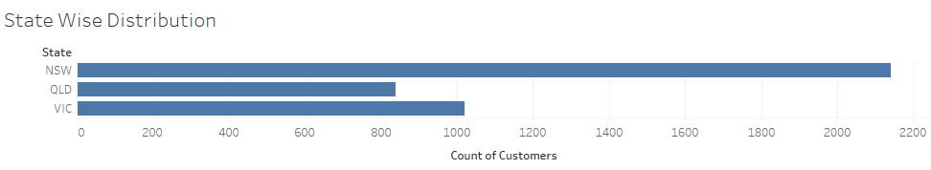
Model Development
State Wise Customer Distribution
The horizontal describes that most of customers come from NSW followed by VIC and QLD.

Slide 9
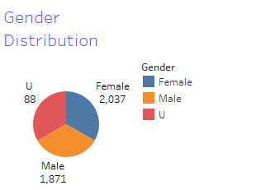
Model Development
Customer Distribution based on Gender
The Pie Chart shows most of customers are Female.

Slide 10
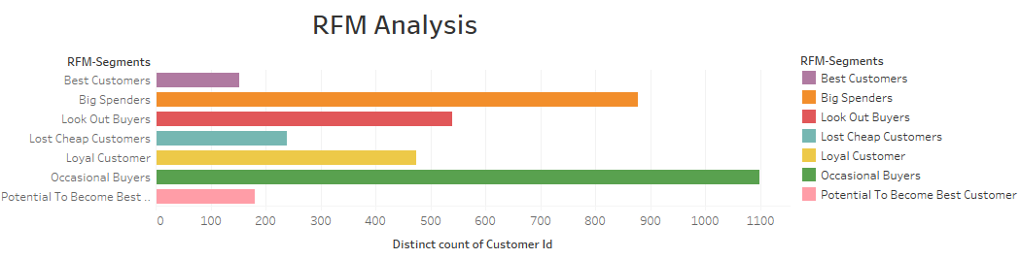
Interpretation
RFM Analysis
1. The RFM Analysis shows most customers are Occasional Buyers. So, more focused should be to convert them to regular customers.
2. There are also a big number of Big Spenders which shows quality of company’s products.

Slide 11
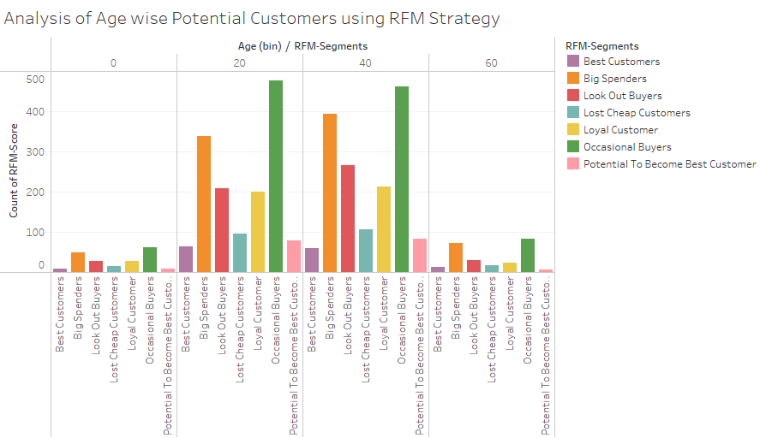
Interpretation
Age Wise RFM Analysis
1. According to side-by-side graph most customers come from 20-40 years age category and are Big Spenders or Occasional Buyers.
Place any supporting images, graphs, data or extra text here.

Slide 12
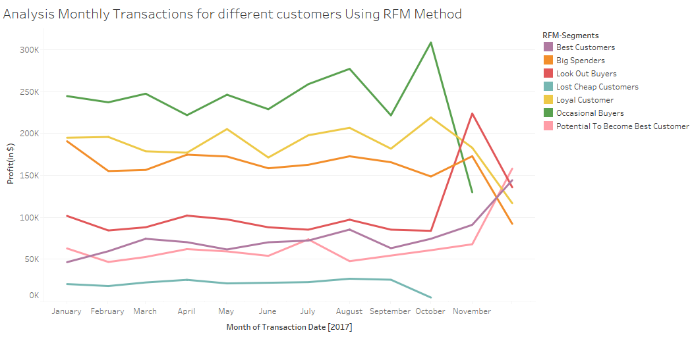
Interpretation
Monthly Analysis of Transactions
August shows a slight increase in profit for all categories.
For both big categories Big Spenders and Occasional Buyers profits start to decline after September.

Slide 13
Interpretation
Potential Future Clients
Based on Our Data Analysis, We found,
Potential Customers lies between age 40-60 years.
Most of them come from Manufacturing, Health and Financial Services.
Most of them are female.
Most of them come from NSW.
Most of them are Mass customers.
Solex and Giant Bicycles are main players of market.

Slide 14
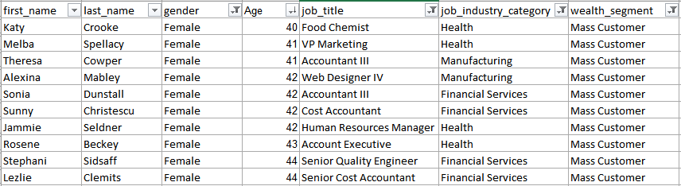
Interpretation
Potential Future Clients
Based on our analysis, we figure out this list of potential customers

